Slide 1
ADVANCED REACT & REDUX
-Lalit Jethani

Slide 2


React Refresher
Why React ?
JSX & Virtual DOM
State and Props
Life Cycle Methods

Slide 3
React Patterns
Composition v/s Inheritance - Favour Composition over Inheritance.
Thinking in React
Render Props
Container Patterns
HOC

Slide 4
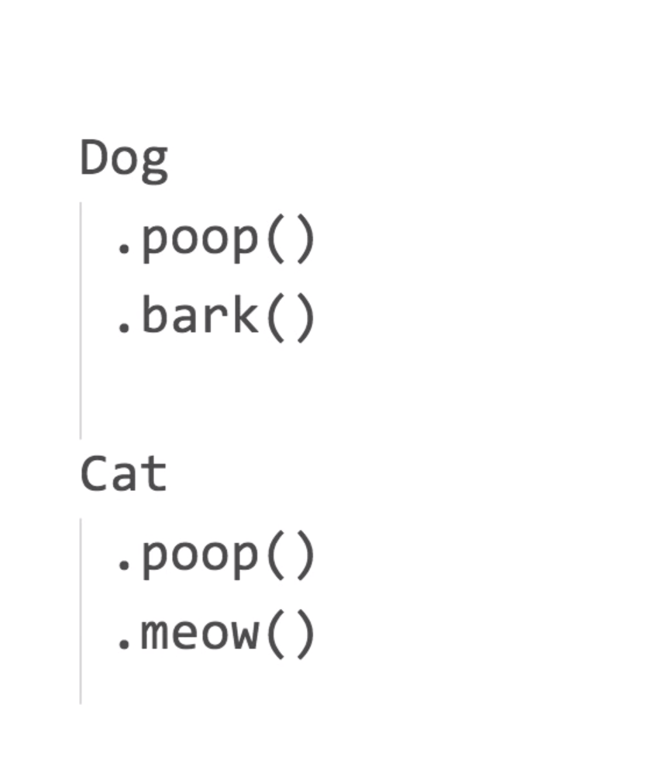
Composition vs Inheritance

Slide 5
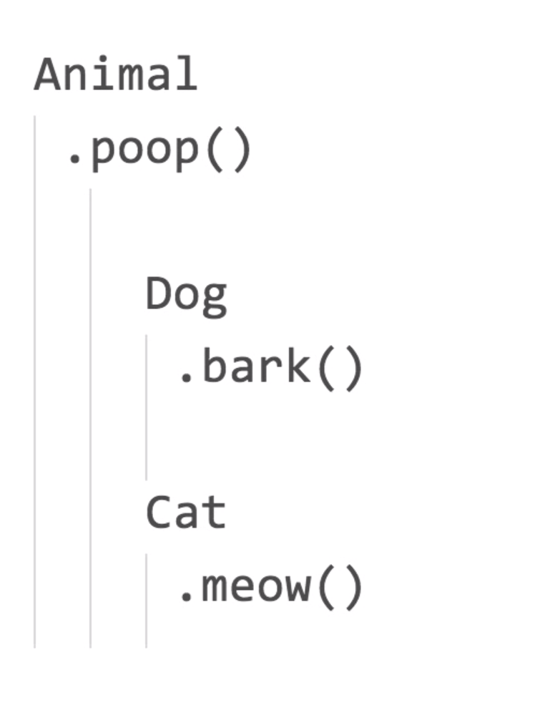
Composition vs Inheritance

Slide 6
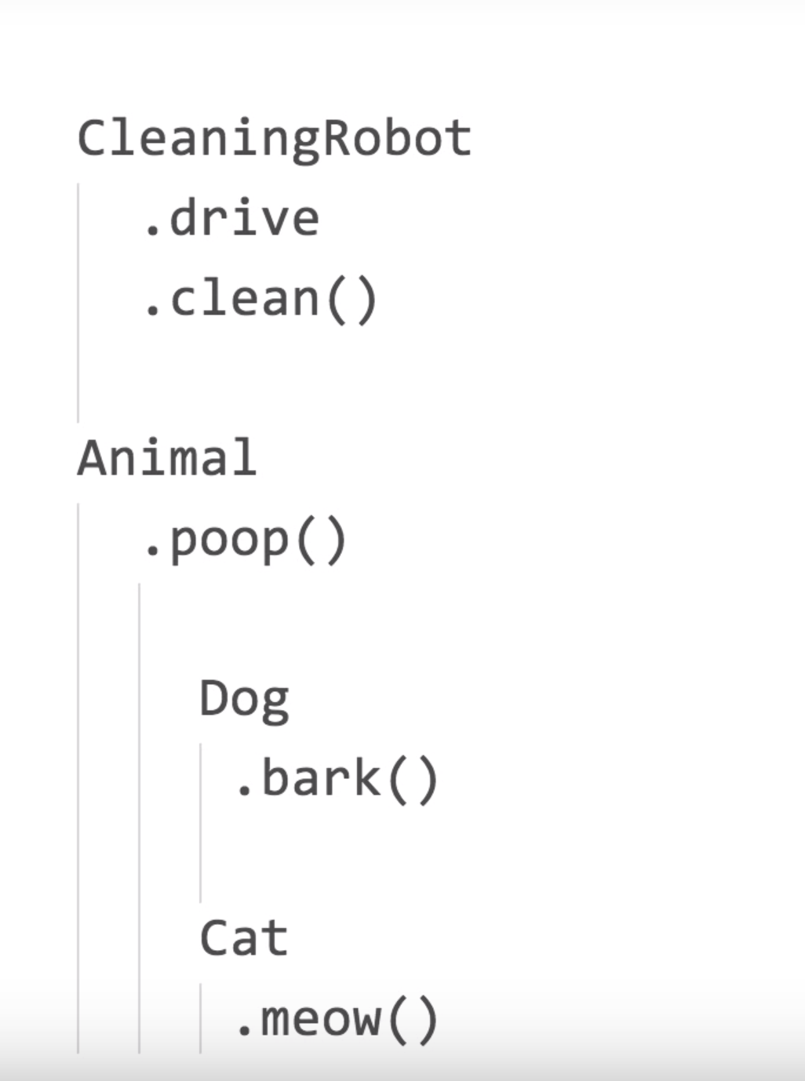
Composition vs Inheritance

Slide 7
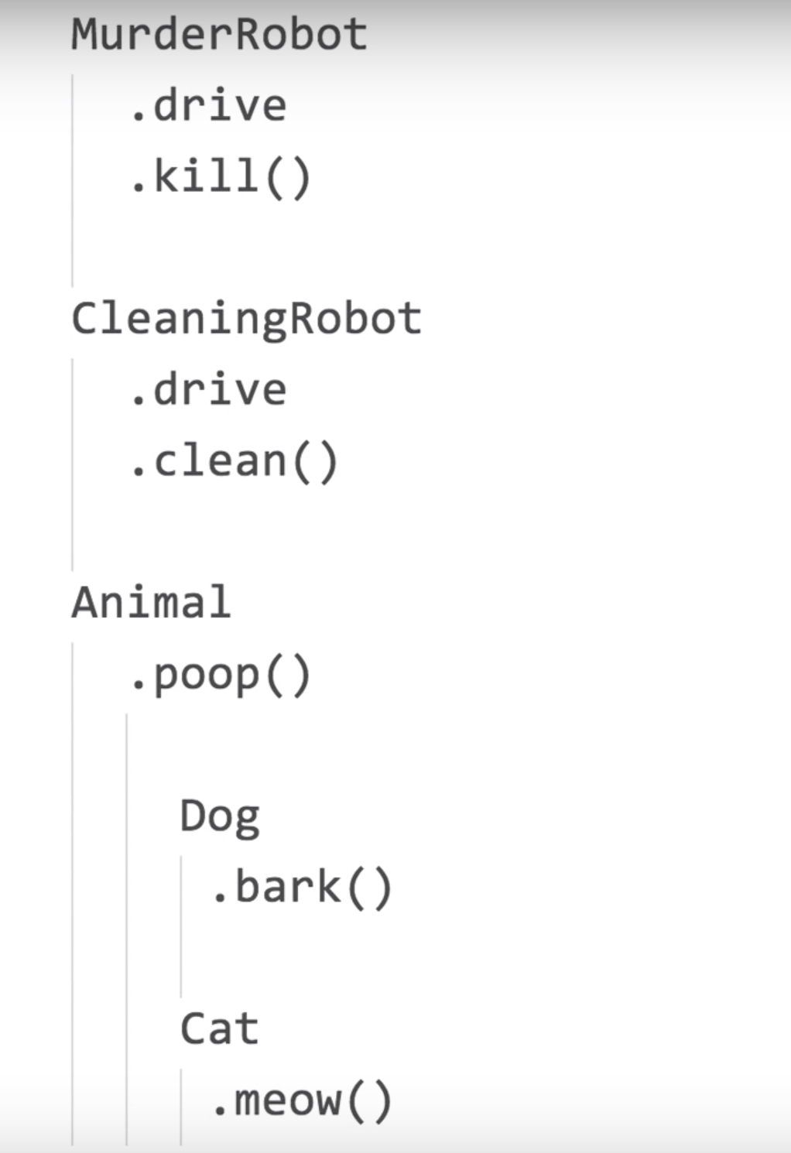
Composition vs Inheritance

Slide 8
Composition vs Inheritance
Manager comes up and says - We now need a MurderRobotDog - A dob who can Kill , Drive and Bark!!

Slide 9
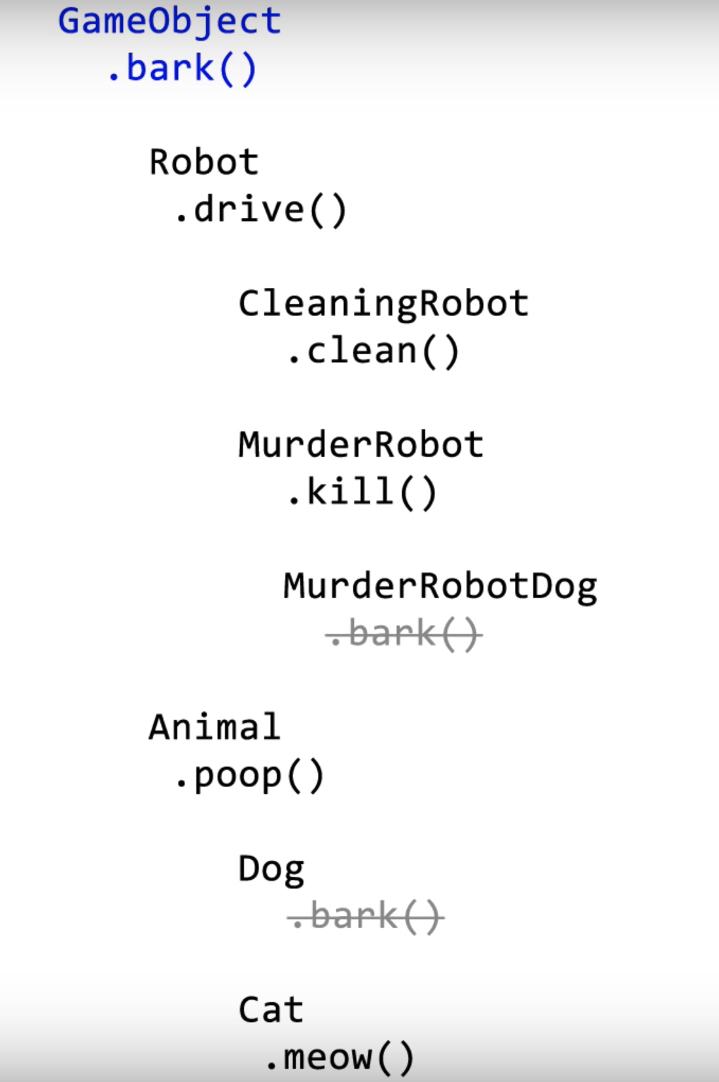
Composition vs Inheritance

Slide 10
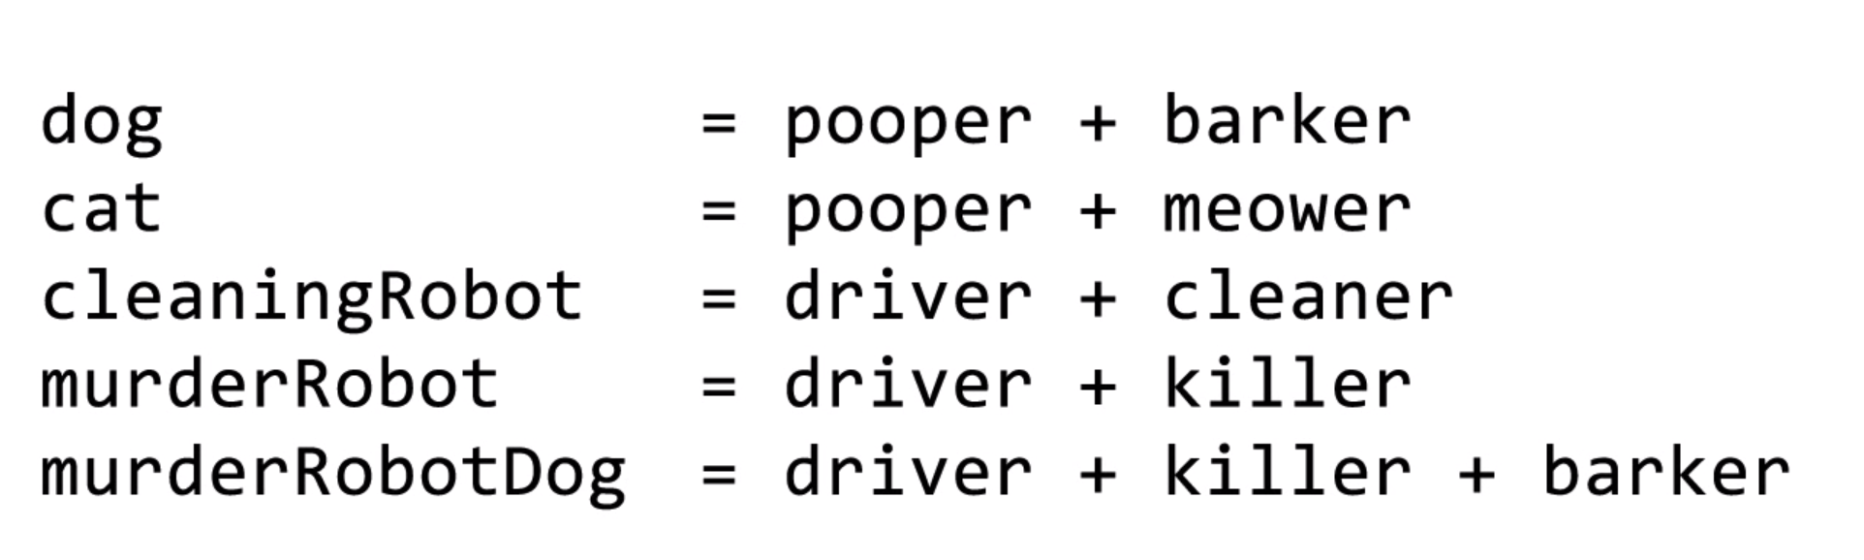
Composition vs Inheritance

Slide 11
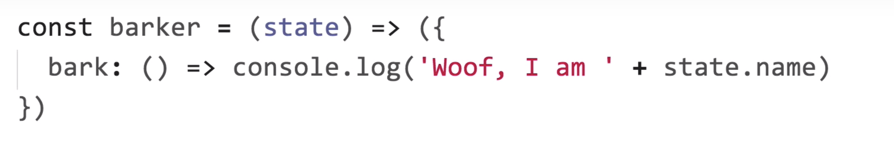
Composition vs Inheritance

Slide 12
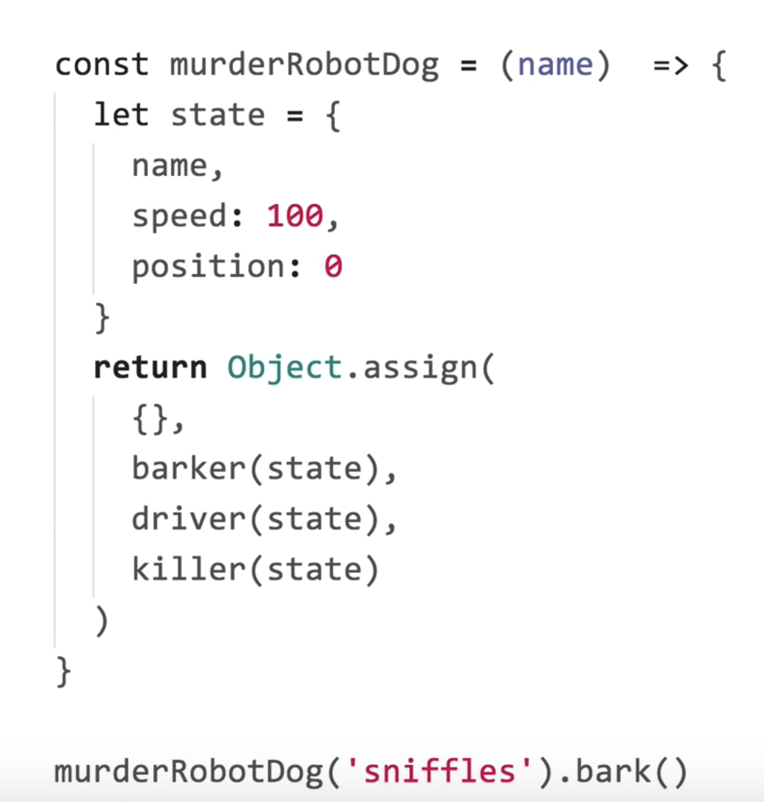
Composition vs Inheritance

Slide 13
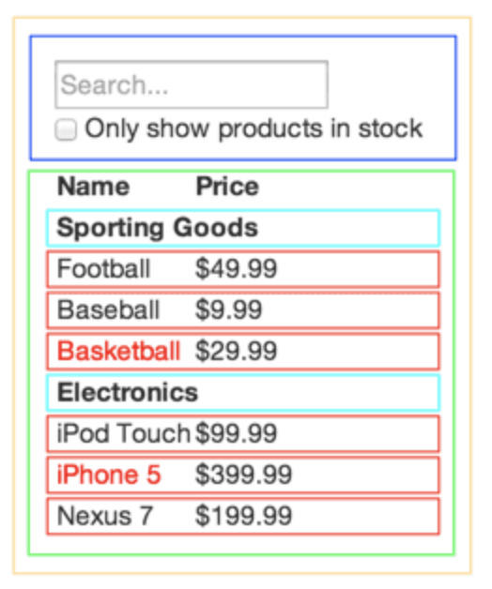
Thinking in React
Step 1: Break The UI Into A Component
Hierarchy

Slide 14
Thinking in React
Step 2: Build a Static version in React

Slide 15
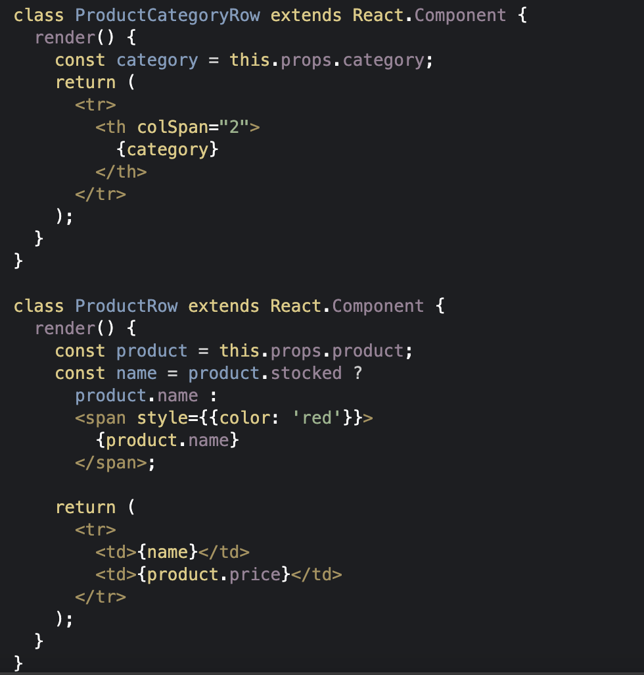
in React

Slide 16
Thinking in React
Step 3: - Identify The Minimal (but complete) Representation Of UI State
Is it passed in from a parent via props? If so, it probably isn’t state.
Does it remain unchanged over time? If so, it probably isn’t state.
Can you compute it based on any other state or props in your component? If so, it isn’t state.

Slide 17
Thinking in React
Step 4: Identify Where Your State Should Live

Slide 18
State Management Theory
Pifalls of local state
Lifting State up
Kinds of State
Managing State outside the Tree

Slide 19
Functional Programming Basics
Pure Functions
Immutablity
First Class functions

Slide 20
Redux
Why Redux
Other state management solutions
Redux refresher
Reducer and State Trees
Combining Reducers
Middlewares
Saga vs Thunk

Slide 21
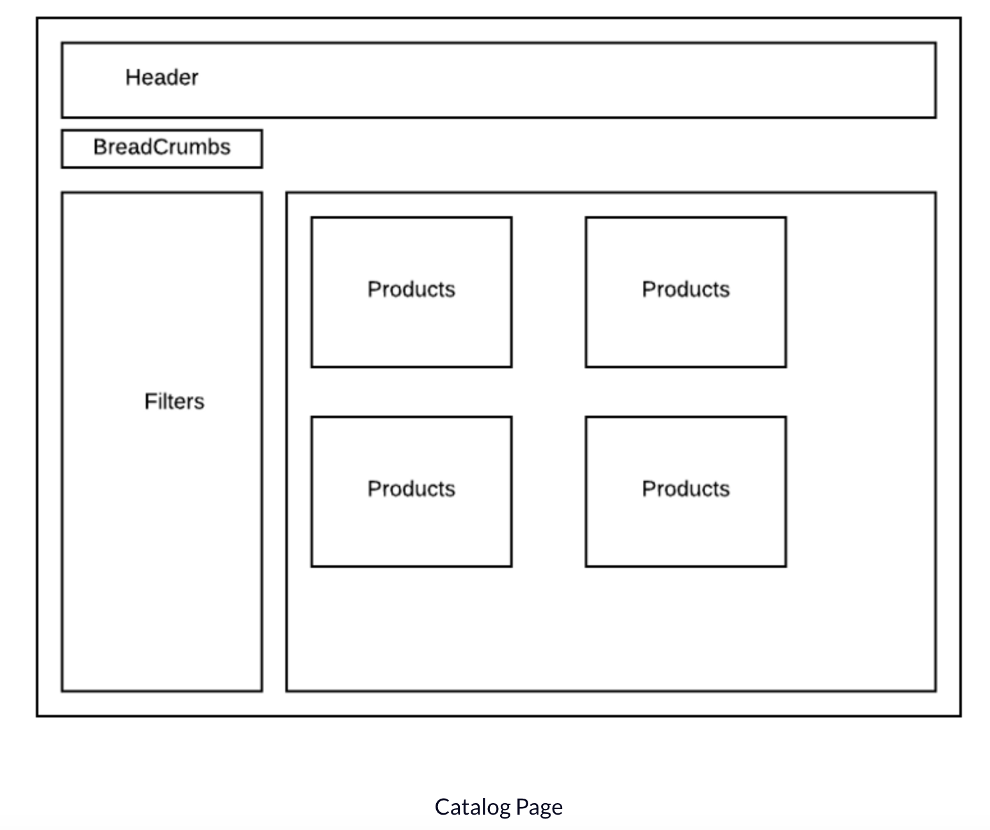
Redux Architecture and Reducer Tree

Slide 22
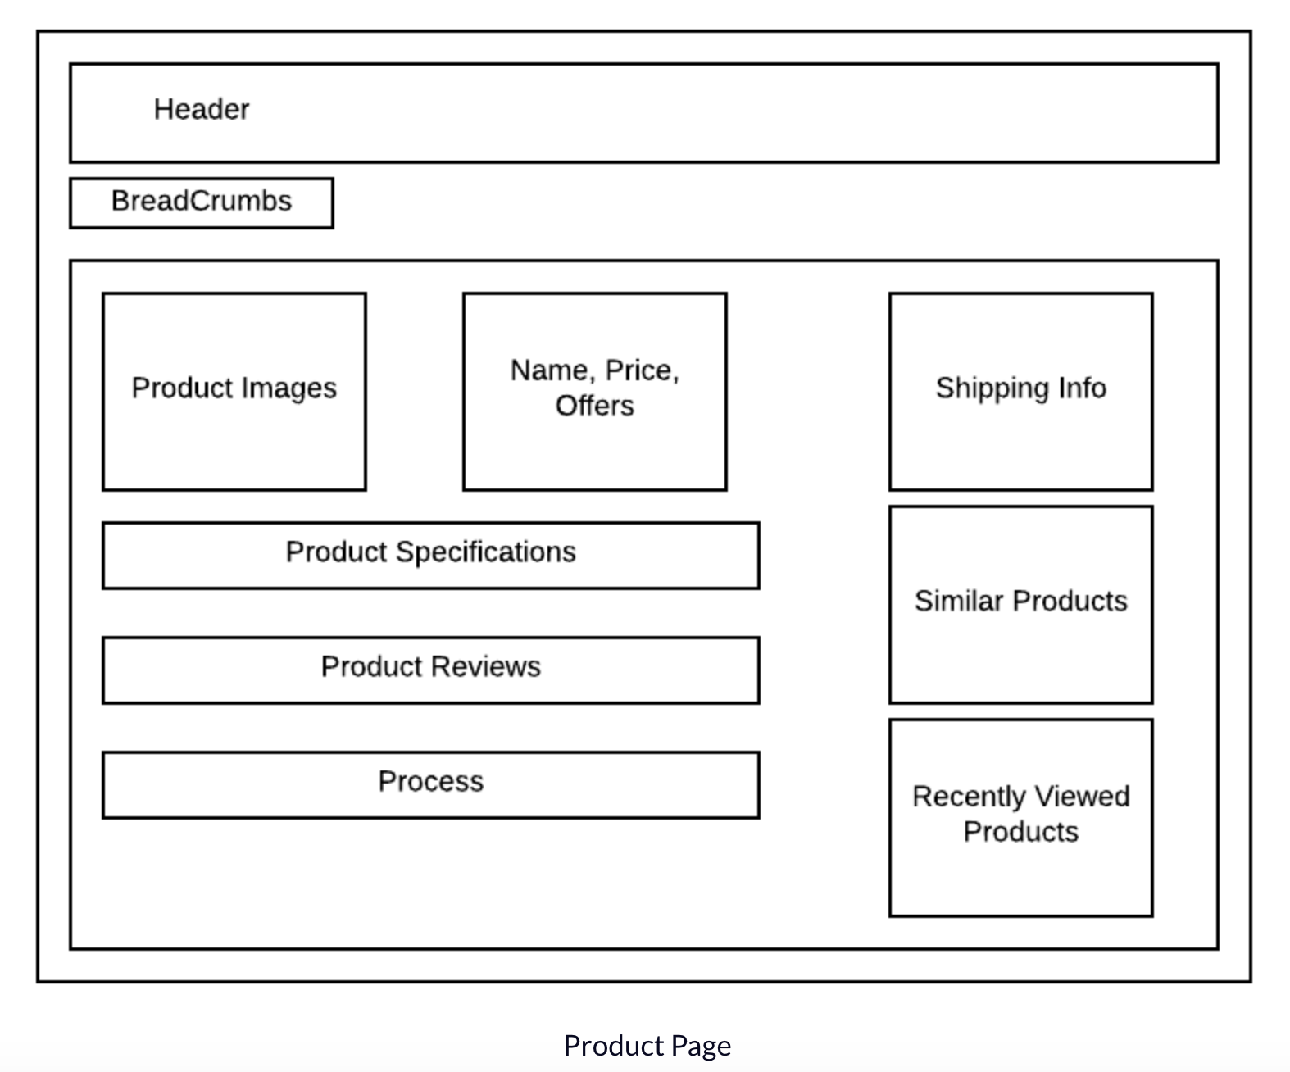
Redux Architecture and Reducer Tree

Slide 23
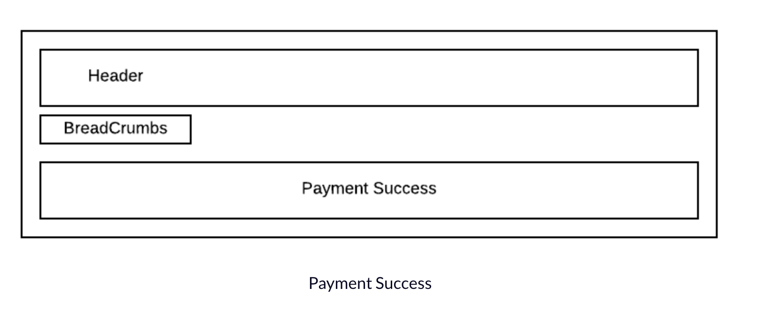
Redux Architecture and Reducer Tree

Slide 24
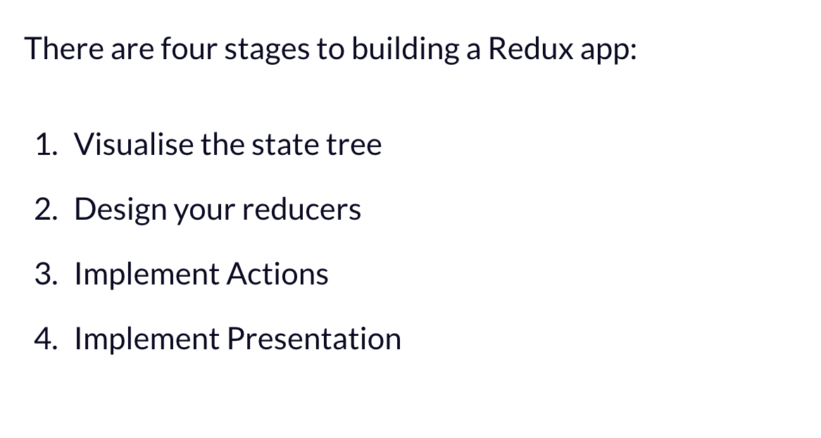
Redux Architecture and Reducer Tree

Slide 25
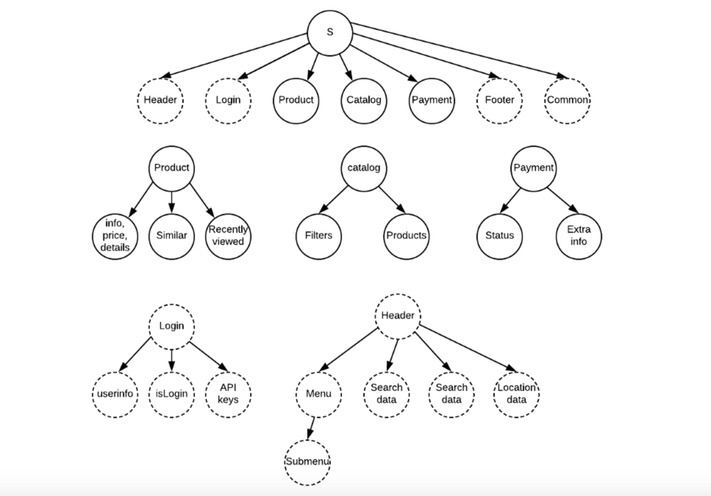

Slide 26
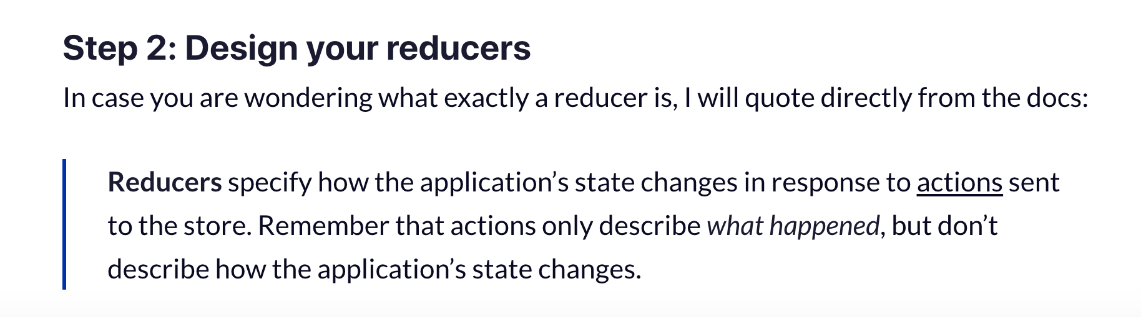
Redux Architecture and Reducer Tree

Slide 27
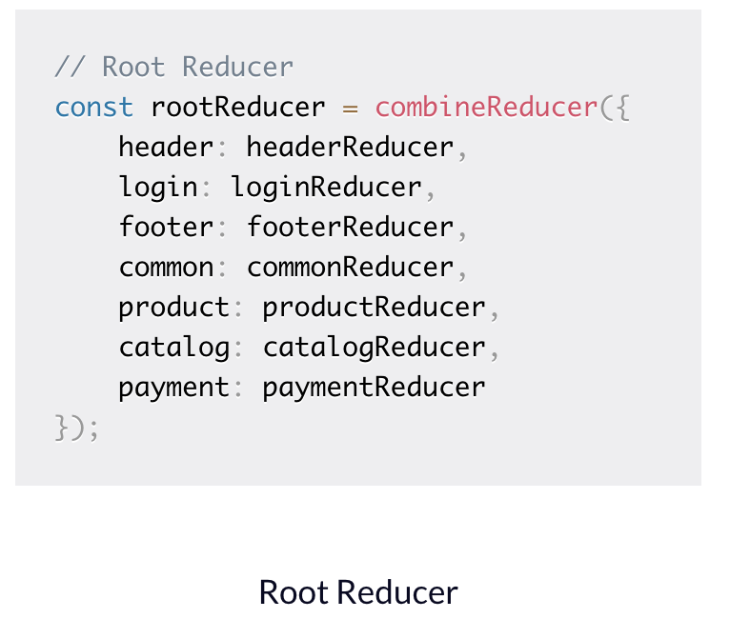
Redux Architecture and Reducer Tree

Slide 28
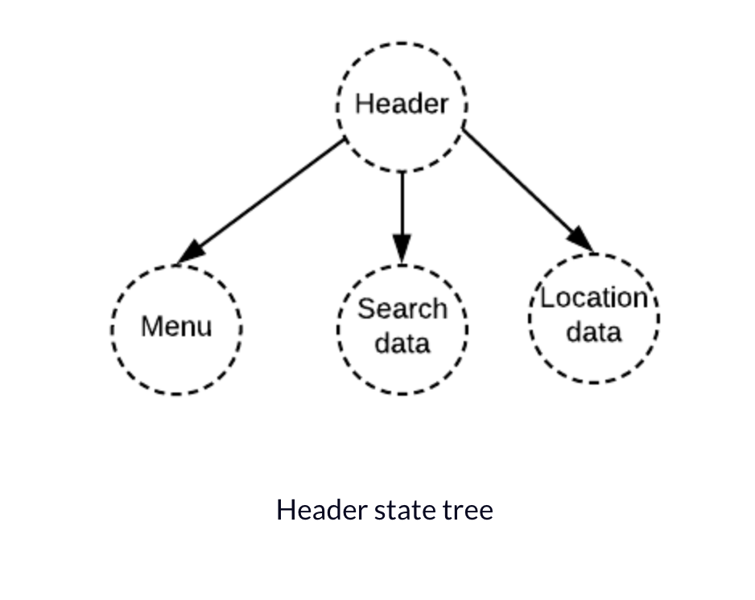
Redux Architecture and Reducer Tree

Slide 29
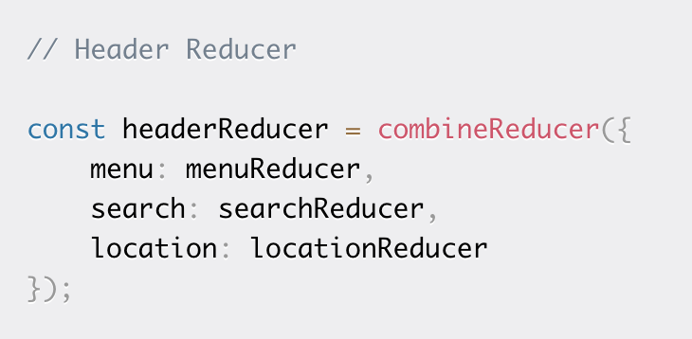
Redux Architecture and Reducer Tree

Slide 30
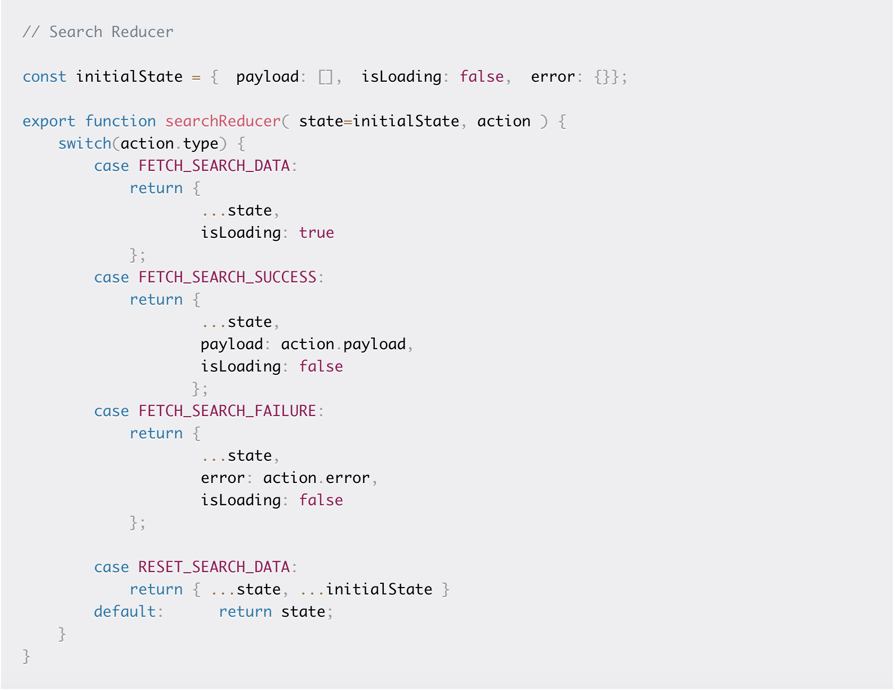
Redux Architecture and Reducer Tree

Slide 31
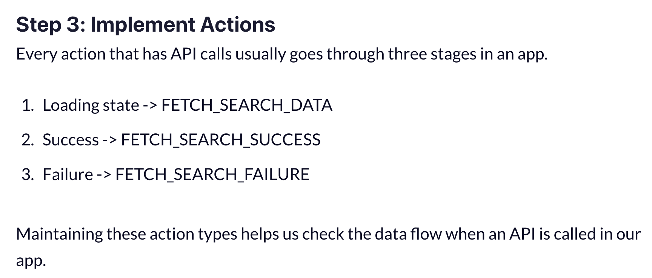
Redux Architecture and Reducer Tree

Slide 32
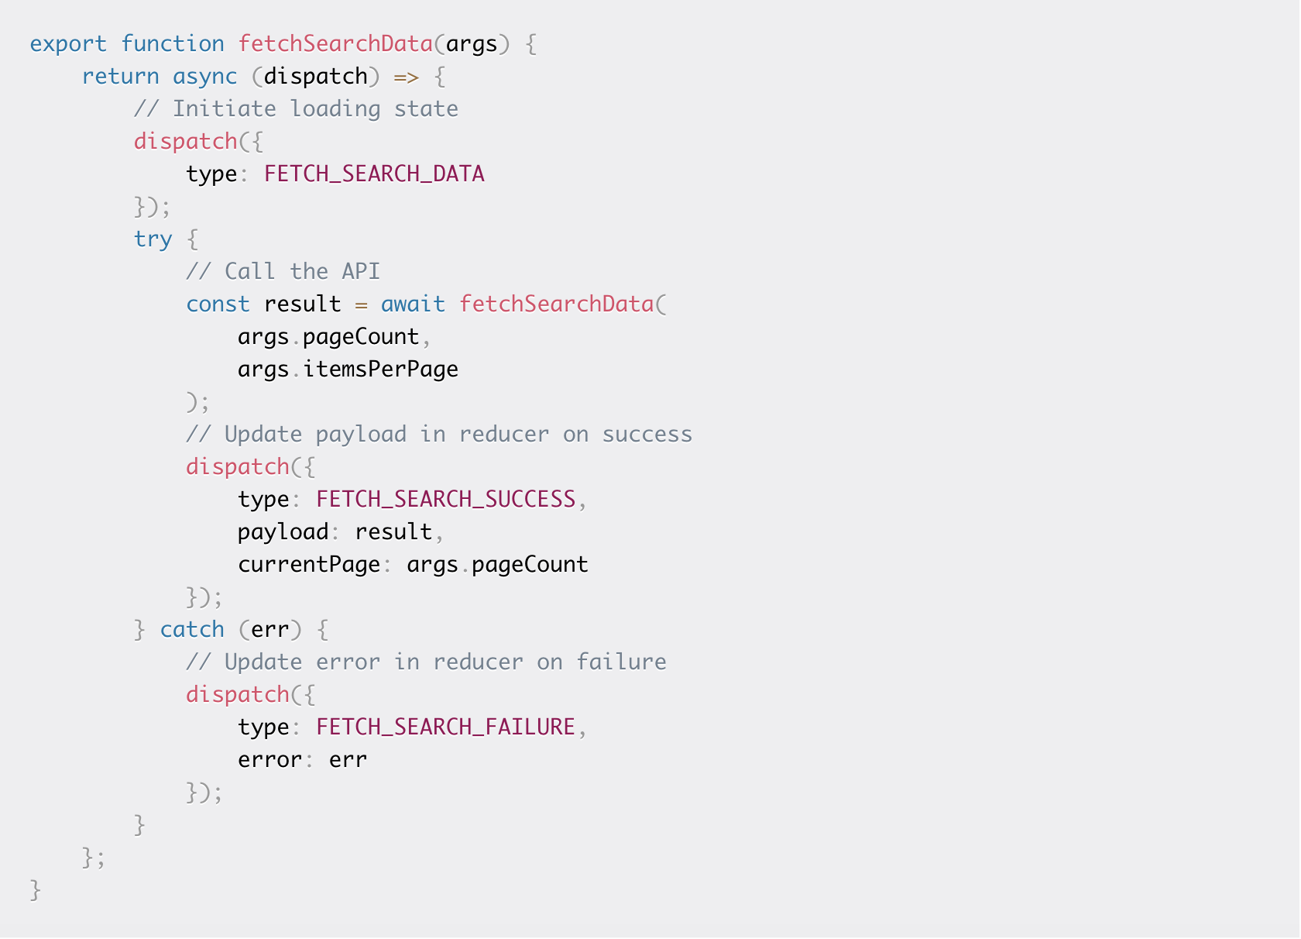
Redux Architecture and Reducer Tree

Slide 33
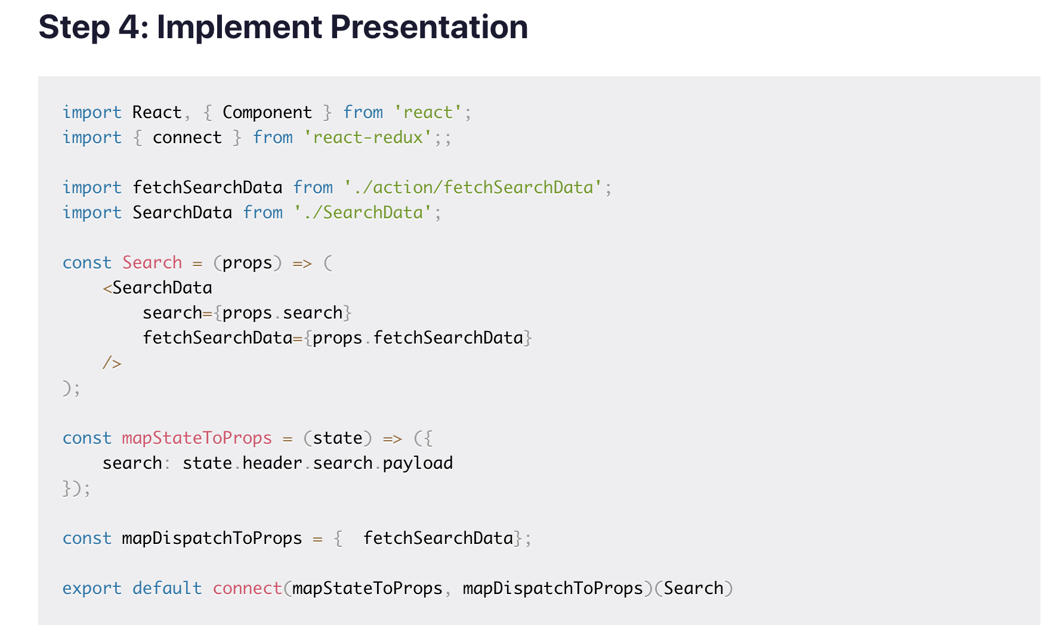
Redux Architecture and Reducer Tree

Slide 34
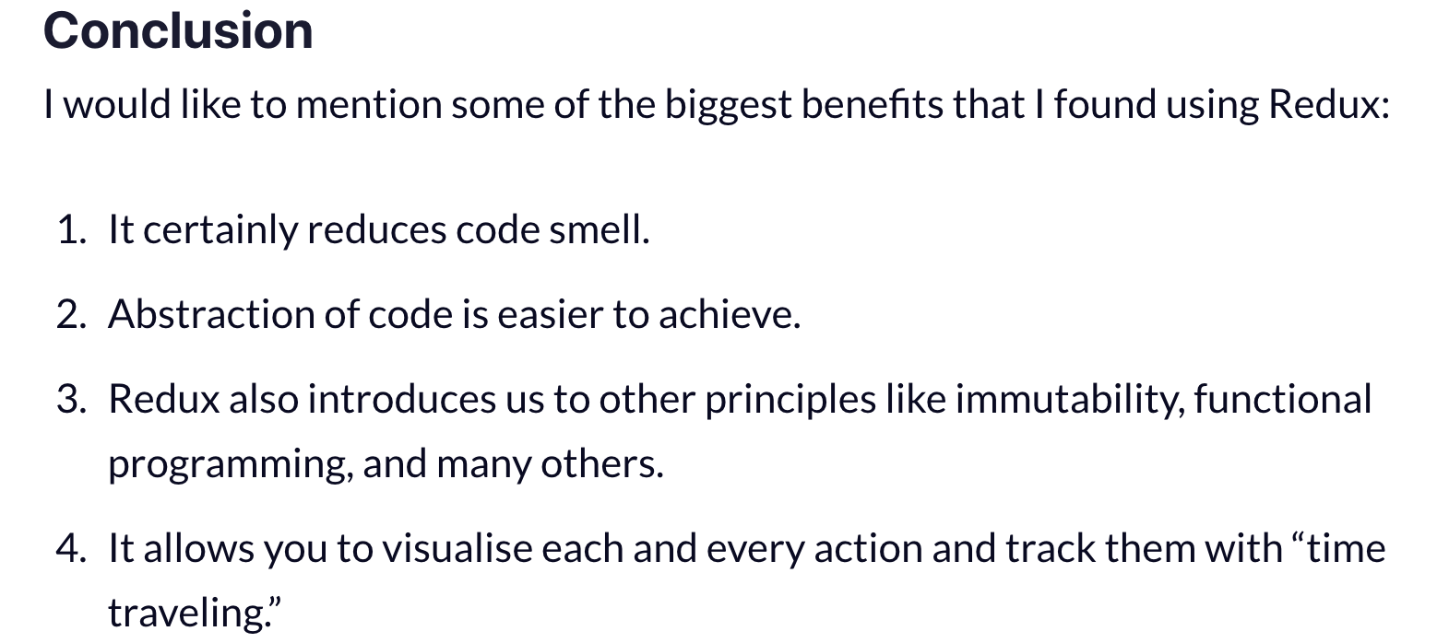
Redux Architecture and Reducer Tree

Slide 35
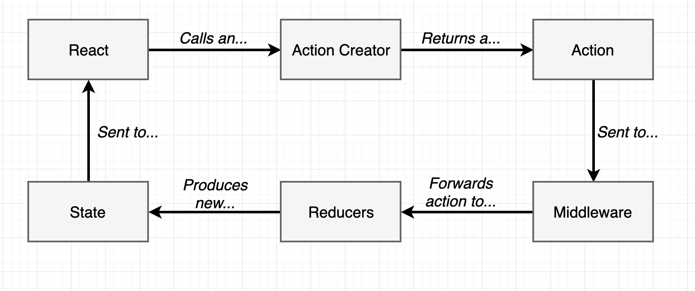
Middleware

Slide 36
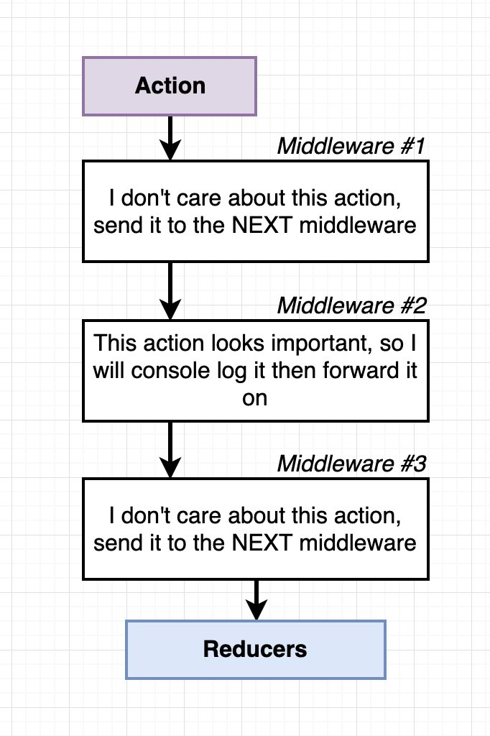
Middleware

Slide 37
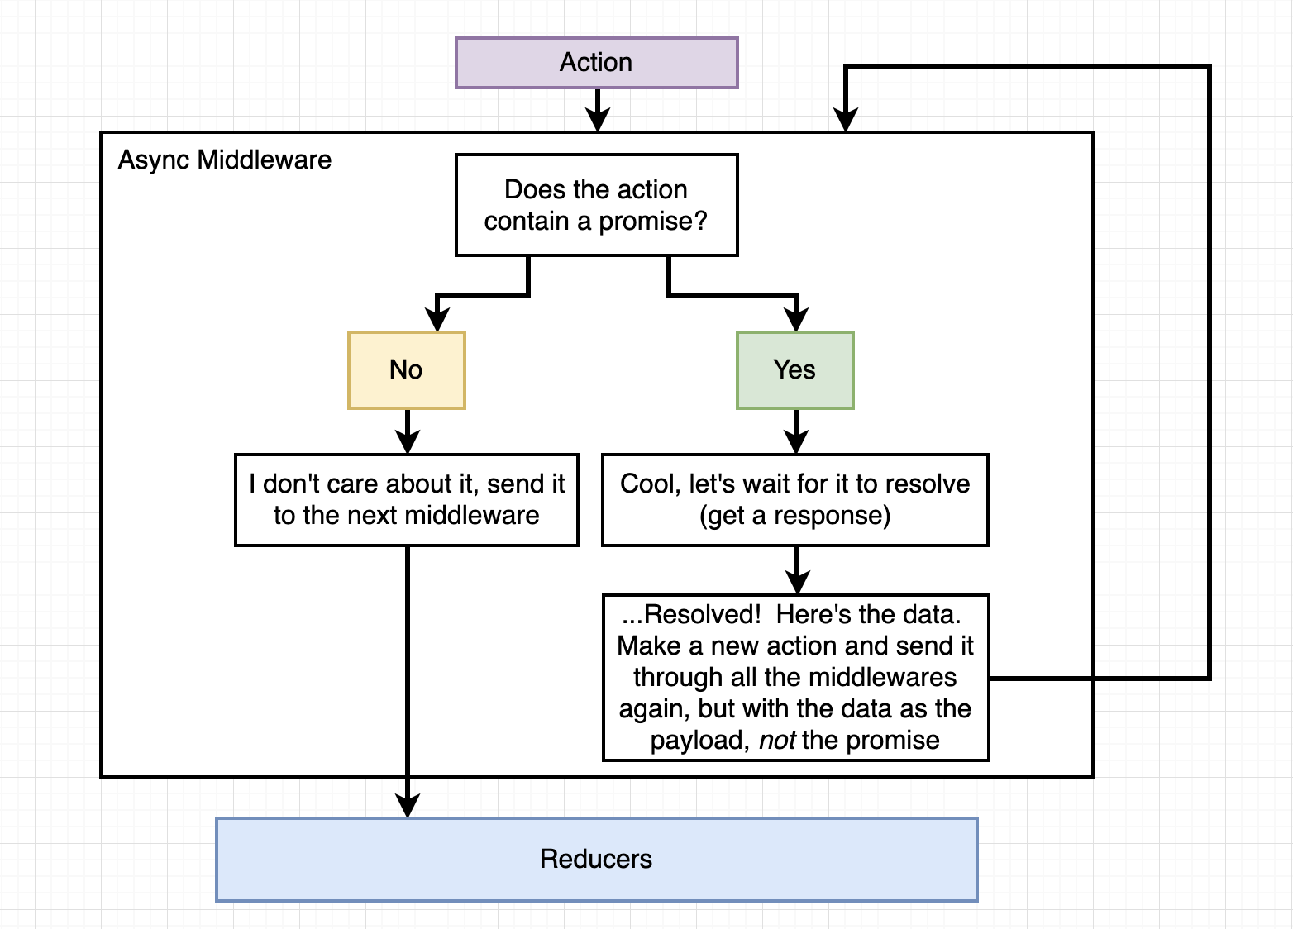
Middleware

Slide 38
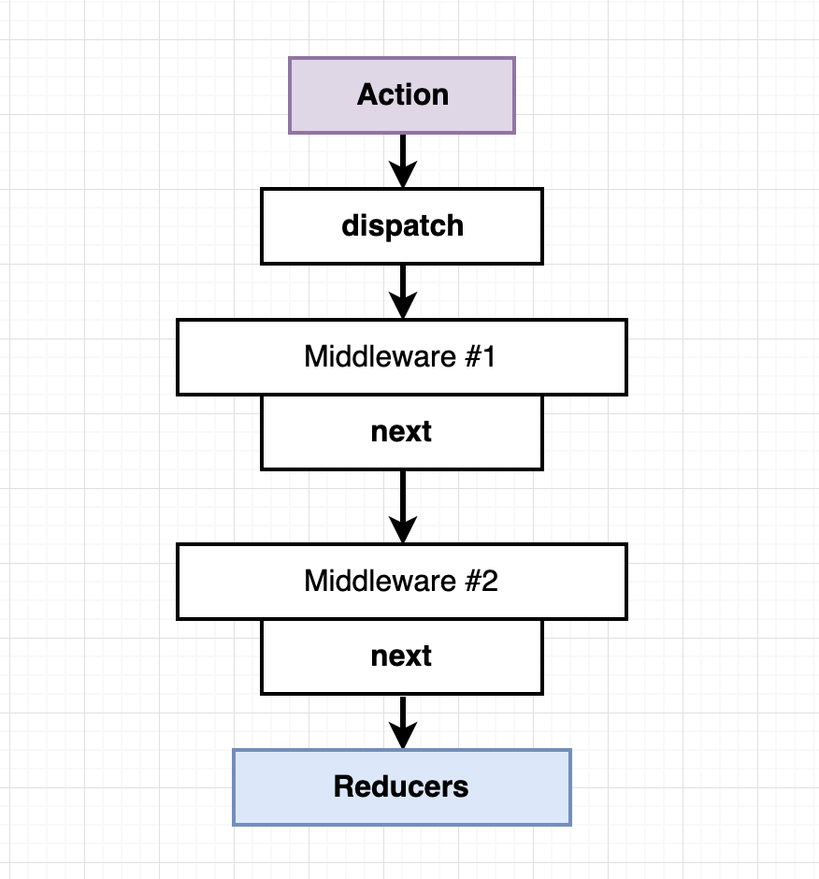
Middleware

Slide 39
4. Performance Optimization
ShouldComponentUpdate
Profiling Components in chrome
Avoid wasteful re render with Pure component
Making Store connected to partial updates
Immutable Data Structures.

Slide 40
4. Code Splitting
Using Dynamic Imports
React.Lazy
React Suspense

Slide 41
const LazyHome = React.lazy(() => import('./Home'))

Slide 42
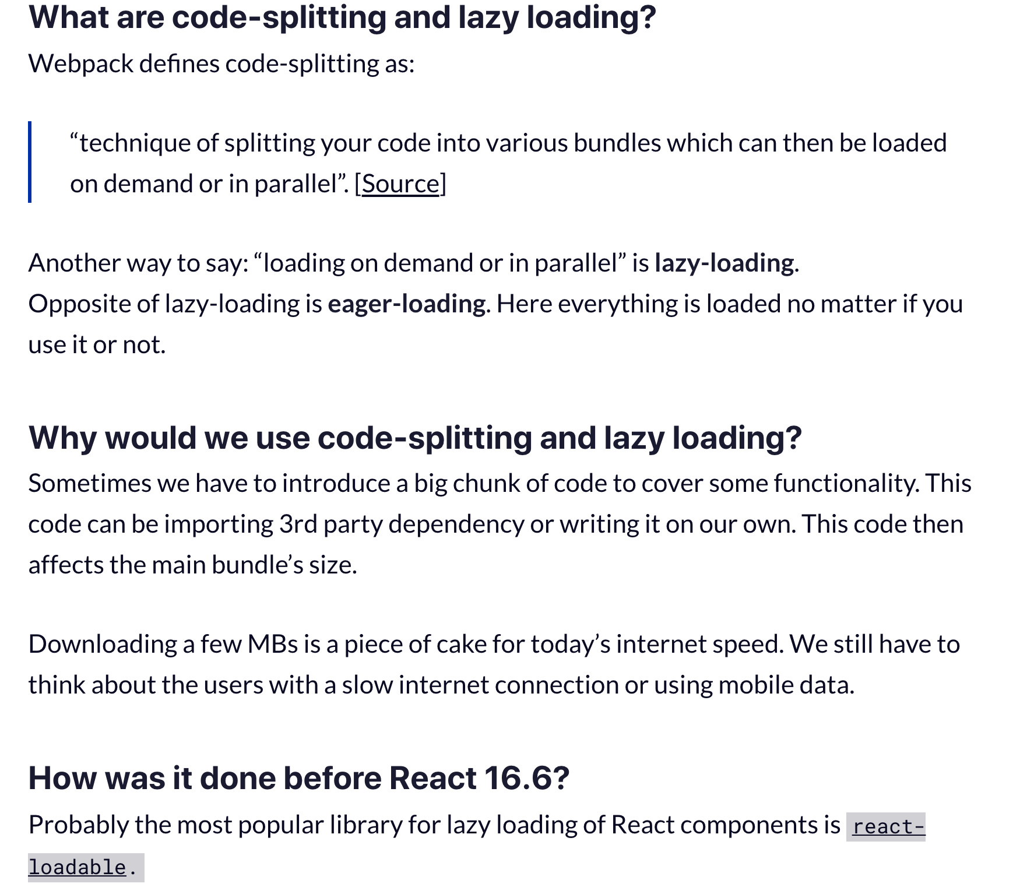

Slide 44
Production Deployment Best Practices
Seprating vendor files
Profiling Components in chrome
Avoid wasteful re render with Pure component
Making Store connected to partial updates
Immutable Data Structures.

Slide 45
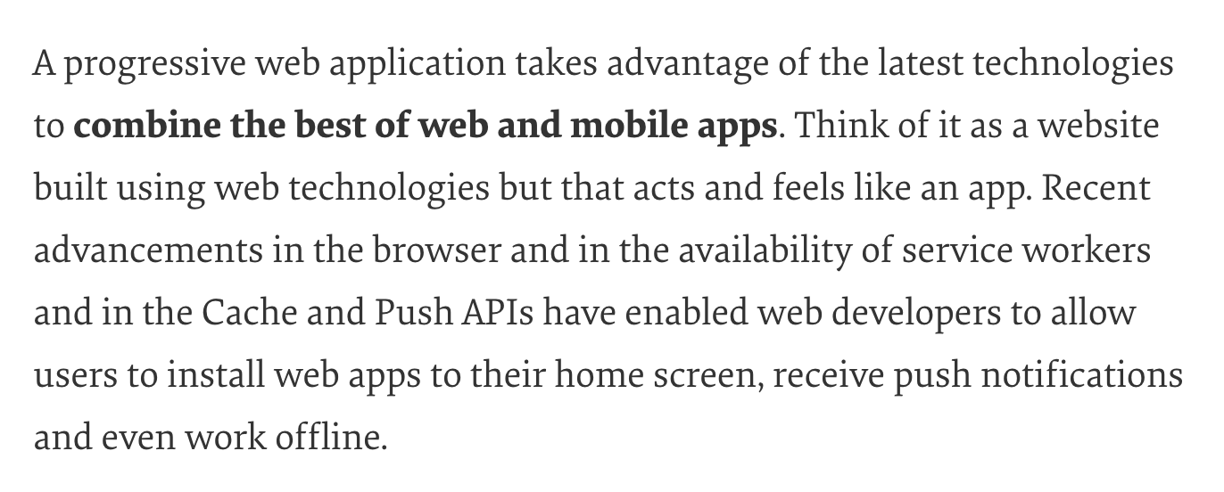
Progressive Web Apps

Slide 46
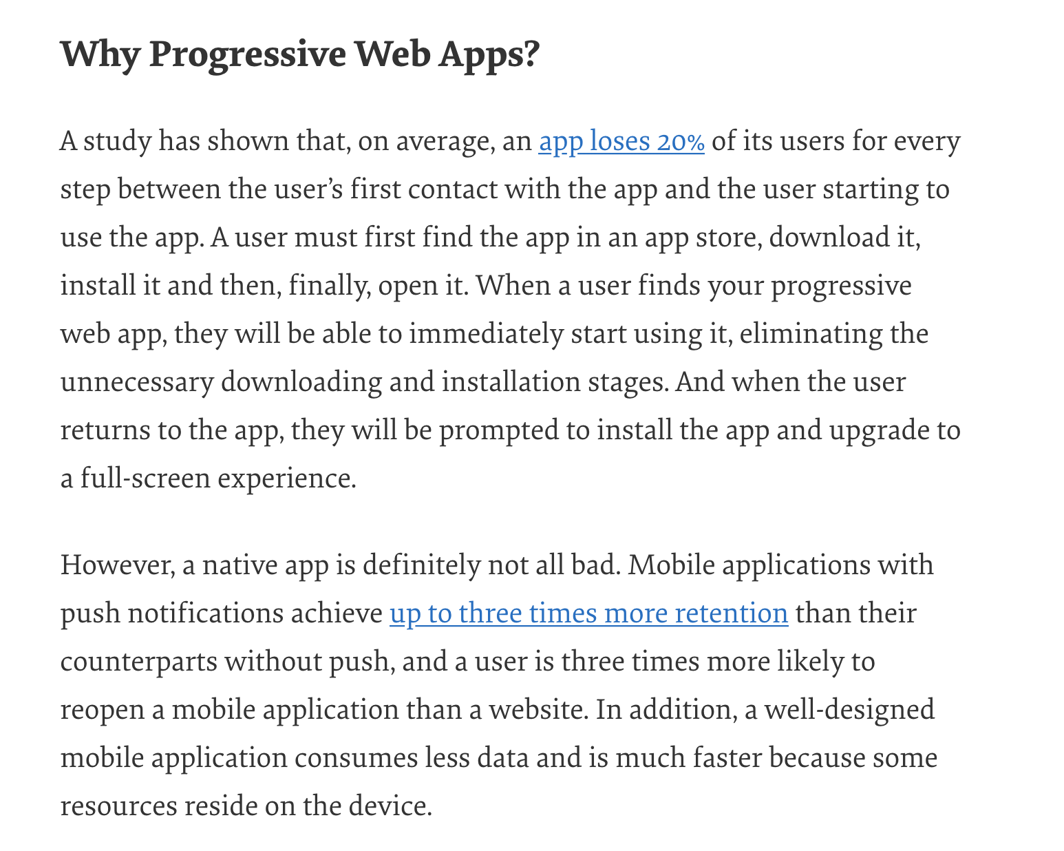
Progressive Web Apps

Slide 47
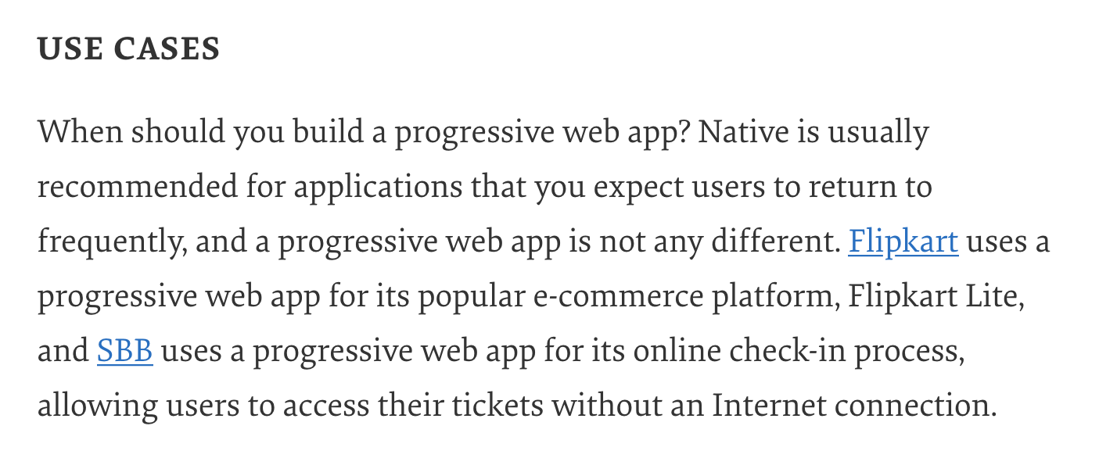
Progressive Web Apps

Slide 48
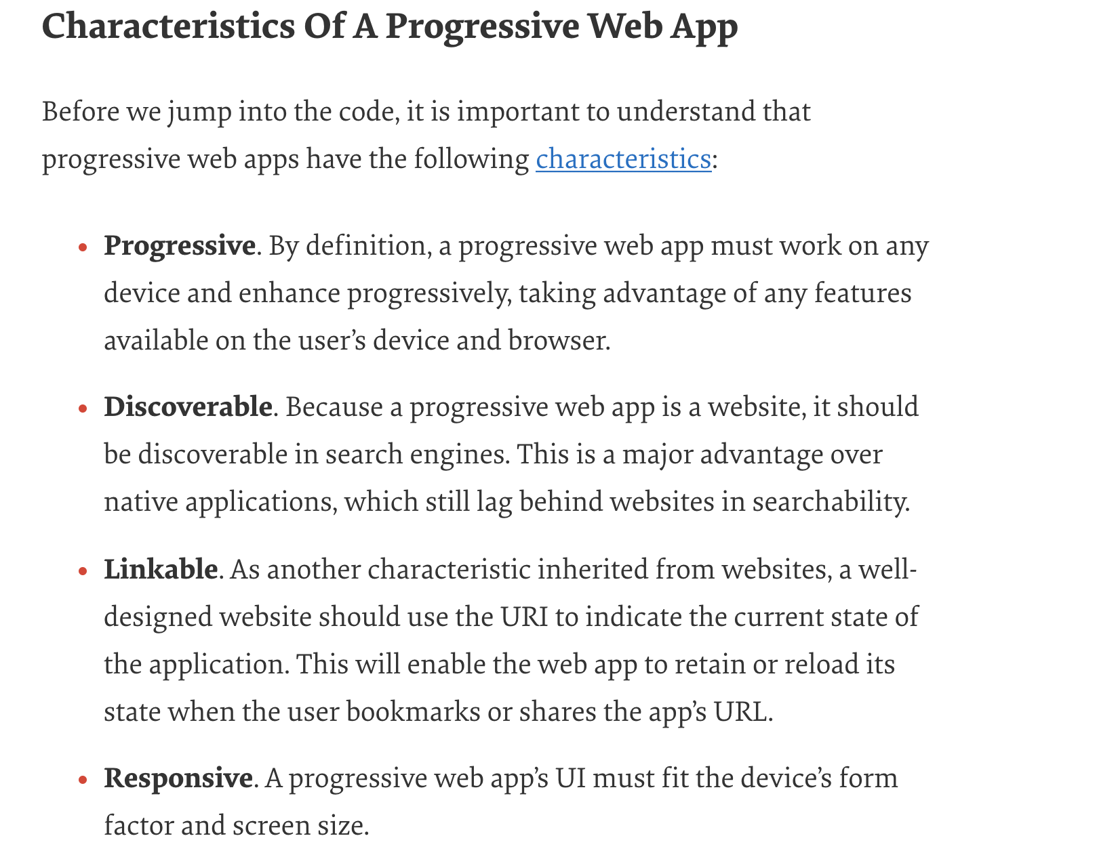
Progressive Web Apps

Slide 49
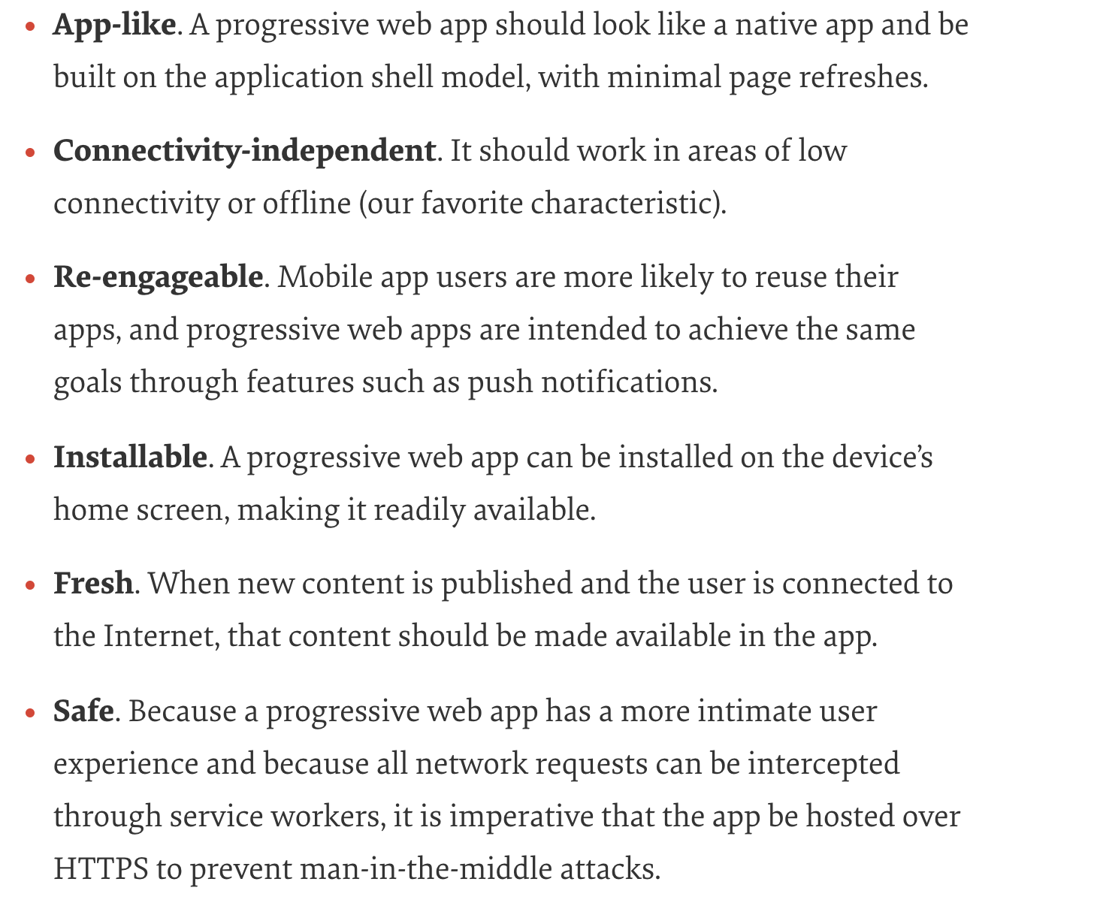
Progressive Web Apps

Slide 50
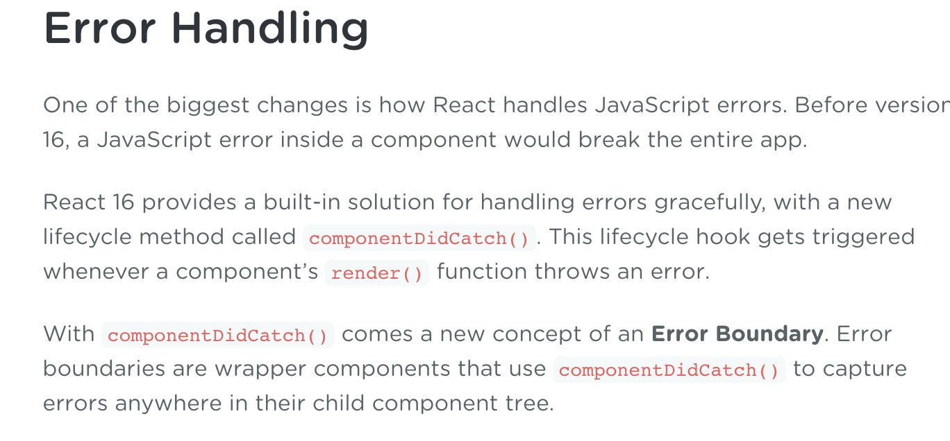
React 16 New Features

Slide 51
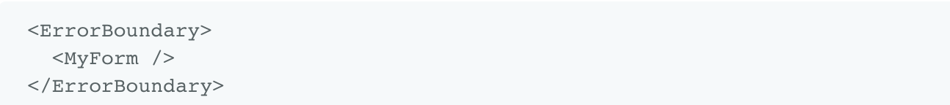
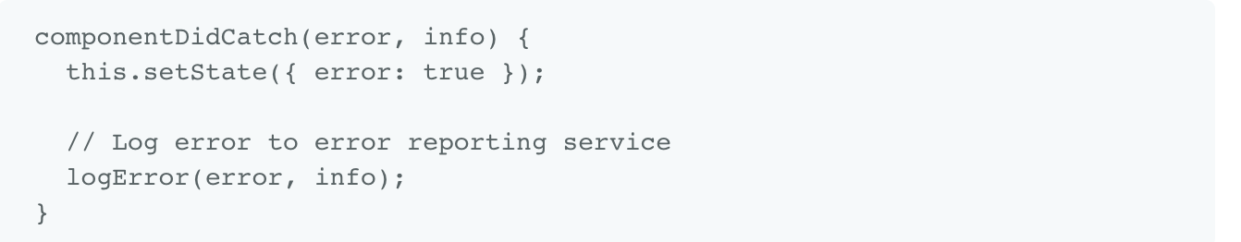
React 16 New Features

Slide 52
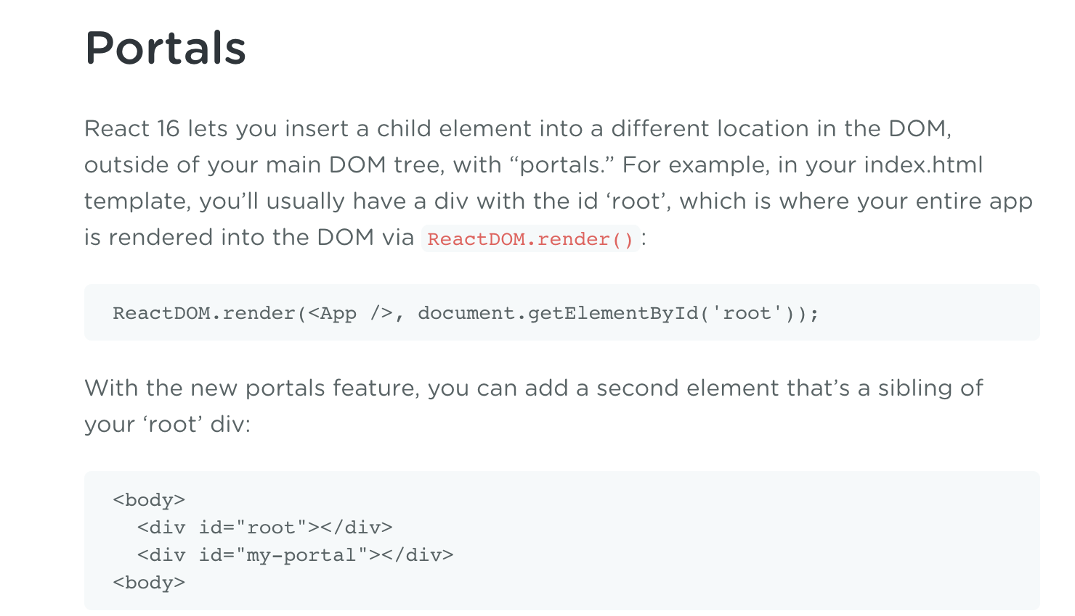
React 16 New Features

Slide 53
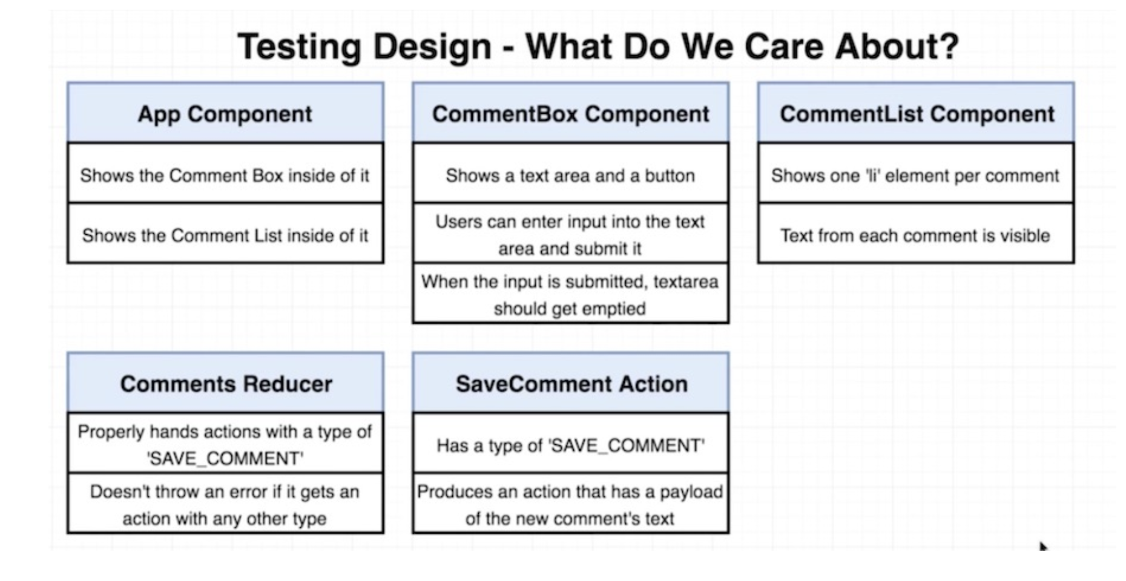
Unit Testing

Slide 54
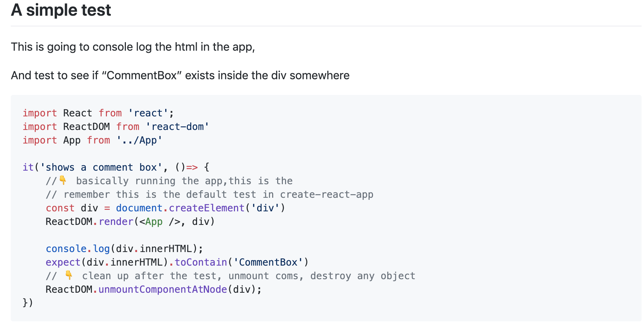
Unit Testing

Slide 55
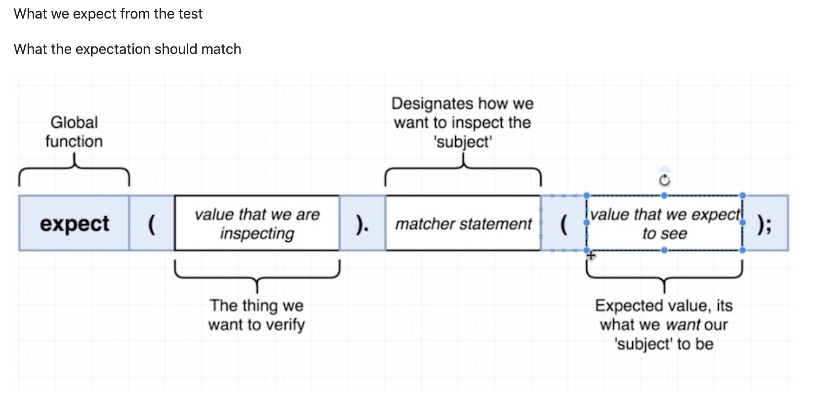
Unit Testing

Slide 56
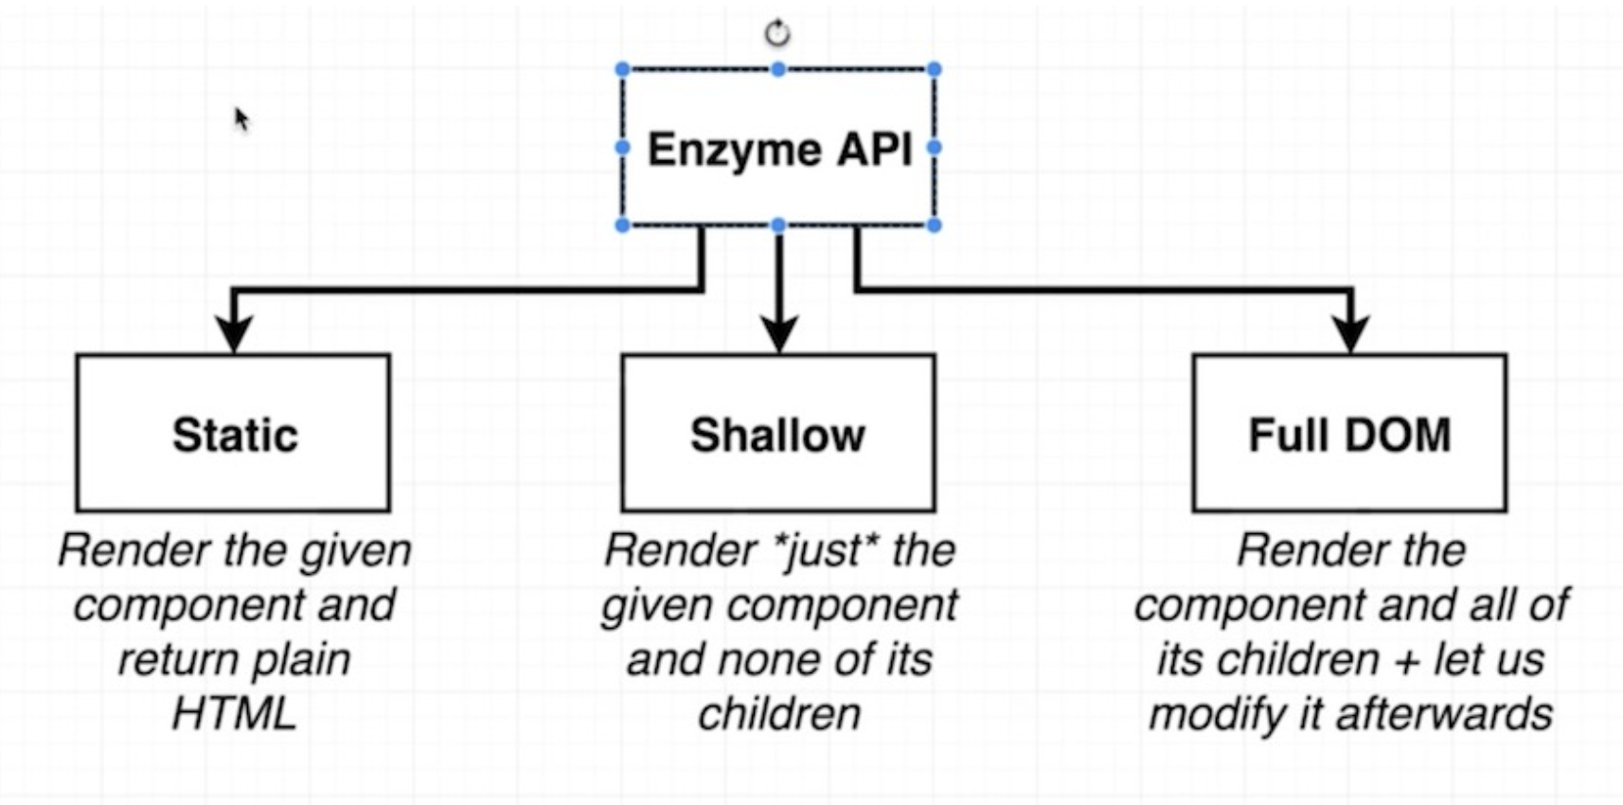
Unit Testing

Slide 57
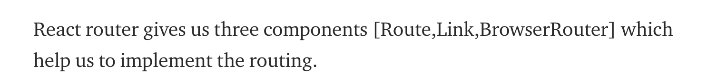
Routing

Slide 58
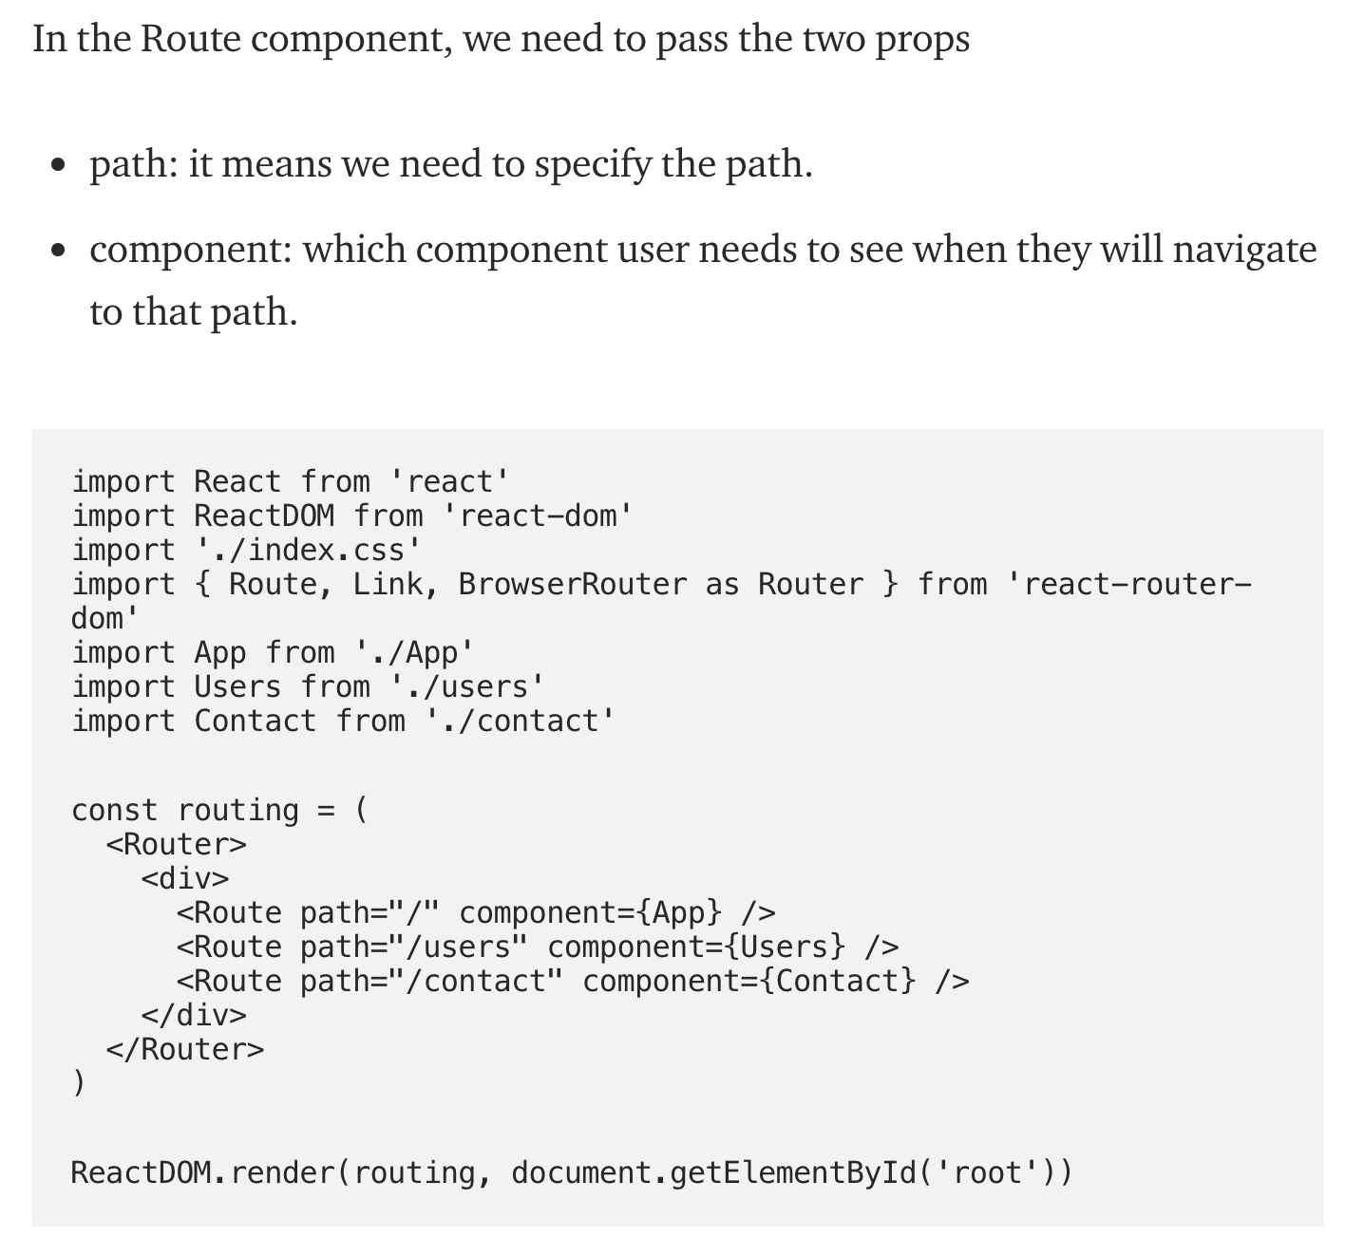
Routing

Slide 59
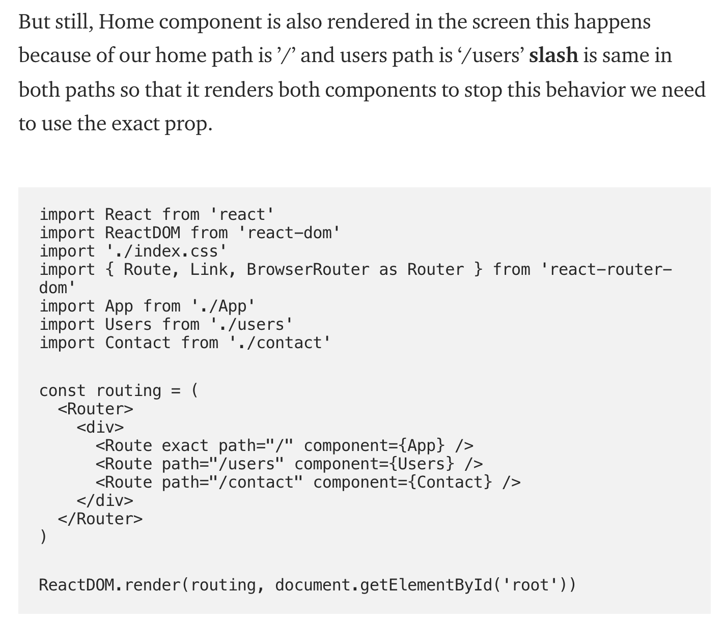
Routing

Slide 60
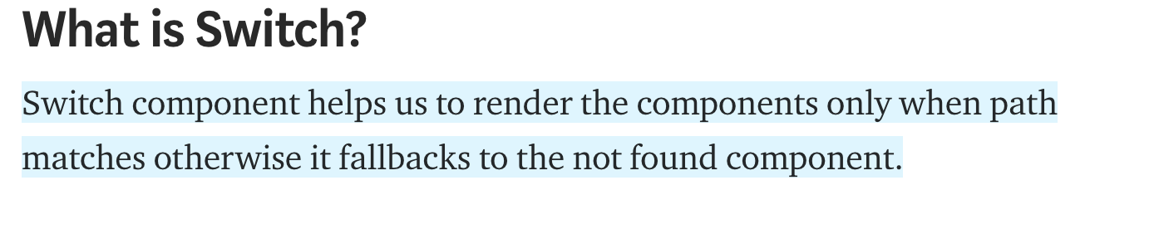
Routing

Slide 61
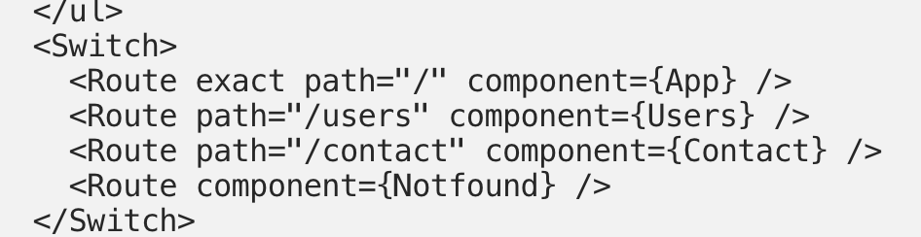
Routing

Slide 62
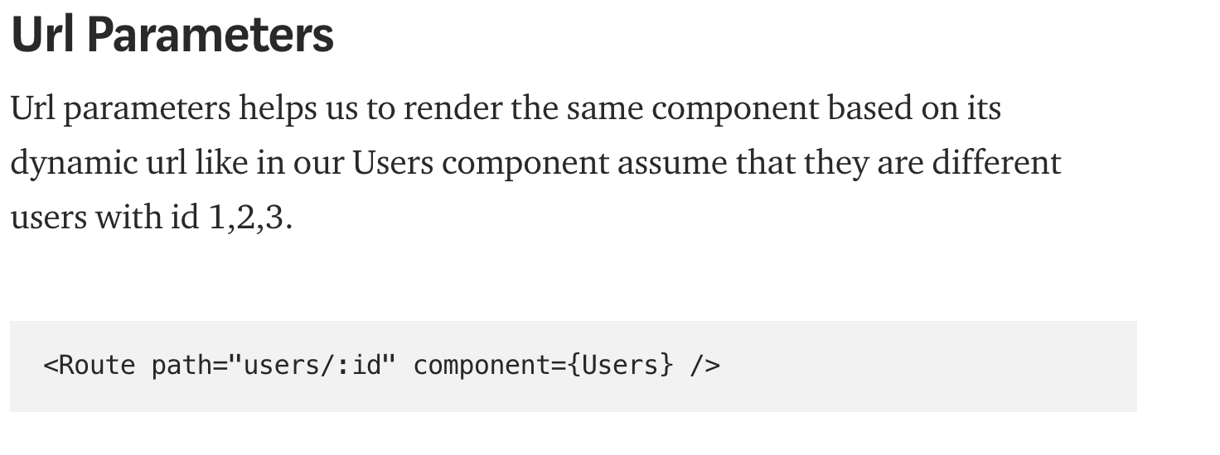
Routing

Slide 63
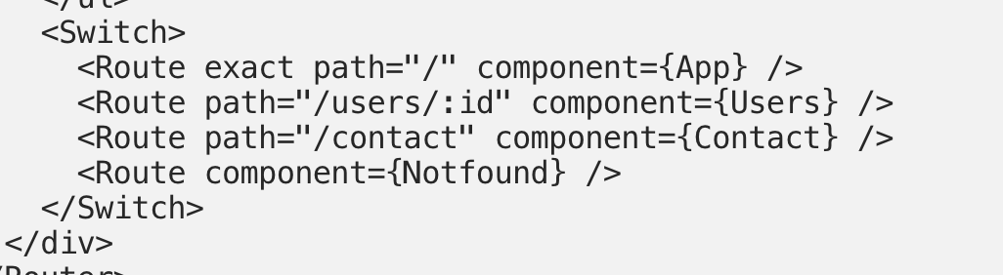
Routing

Slide 64

Routing

Slide 65
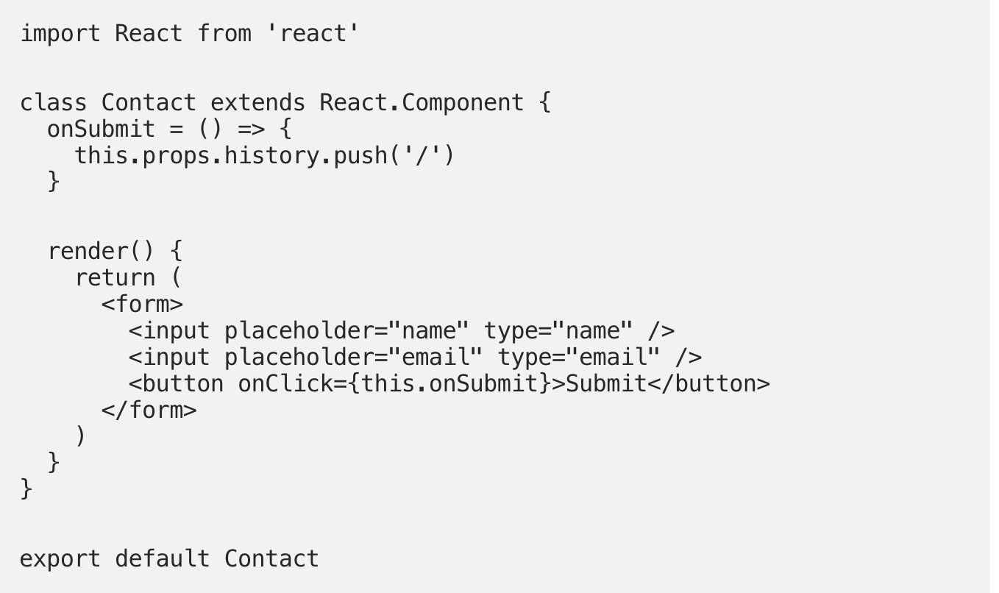
Routing

Slide 66

Redux-Saga

Slide 67

Redux-Saga

Slide 68

Redux-Saga

Slide 69

Redux-Saga

Slide 70

Redux-Saga

